Slide 1
Introducing JavaServer Pages

Slide 2
Agenda
Why we need JSP
How JSP works
Benefits of JSP
Setting up your environment for JSP
A simple example
JSP Intro

Slide 3
The Need for JSP
With servlets, it is easy to
  Read form data
  Read HTTP request headers
  Set HTTP status codes and response headers
  Use cookies and session tracking
  Share data among servlets
  Remember data between requests
  Get fun, high-paying jobs
But, it sure is a pain to
  Use those println statements to generate HTML
  Maintain that HTML
JSP Intro

Slide 4
The JSP Framework
Idea:
  Use regular HTML for most of page
  Mark servlet code with special tags
  Entire JSP page gets translated into a servlet (once), and servlet is what actually gets invoked (for each request)
Example:
  JSP
    Thanks for ordering
    <I><%= request.getParameter("title") %></I>
  URL
    http://host/OrderConfirmation.jsp
    ?title=Core+Web+Programming
  Result
    Thanks for ordering Core Web Programming
JSP Intro

Slide 5
Benefits of JSP
Although JSP technically can't do anything servlets can't do, JSP makes it easier to:
  Write HTML
  Read and maintain the HTML
JSP makes it possible to:
  Use standard HTML tools such as Allaire HomeSite, Macromedia DreamWeaver, or Adobe GoLive.
  Have different members of your team do the HTML layout than do the Java programming
JSP encourages you to
  Separate the (Java) code that creates the content from the (HTML) code that presents it
JSP Intro

Slide 6
Advantages of JSP Over Competing Technologies
Versus ASP or ColdFusion
  Better language for dynamic part
  Portable to multiple servers and operating systems
Versus PHP
  Better language for dynamic part
  Better tool support
Versus pure servlets
  More convenient to create HTML
  Can use standard tools (e.g., HomeSite)
  Divide and conquer
  JSP programmers still need to know
  servlet programming
JSP Intro

Slide 7
Advantages of JSP (Continued)
Versus Velocity or WebMacro
  Standard
Versus client-side JavaScript (in browser)
  Capabilities mostly do not overlap with JSP, but
    You control server, not client
    Richer language
Versus server-side JavaScript
(eg, LiveWire, BroadVision, JRun)
  Richer language
Versus static HTML
  Dynamic features
  Adding dynamic features no longer
  "all or nothing" decision
JSP Intro

Slide 8
Setting Up Your Environment
Set your CLASSPATH. Not.
Compile your code. Not.
Use packages to avoid name conflicts. Not.
Put JSP page in special directory. Not.
  install_dir\webapps\ROOT\ (HTML and JSP -- Tomcat)
  install_dir\servers\default\default-app (JRun)
  Some servers reserve certain parts of Web hierarchy for JSP pages. Tomcat 3 and JRun (standalone) don't.
Use special URL to invoke JSP page. Not.
Caveats
  Previous rules about CLASSPATH, install dirs, etc., still apply to regular Java classes used by a JSP page
JSP Intro

Slide 9
Example
<!DOCTYPE HTML PUBLIC
"-//W3C//DTD HTML 4.0 Transitional//EN">
<HTML>
<HEAD>
<TITLE>JSP Expressions</TITLE>
<META NAME="author" CONTENT="Marty Hall">
<META NAME="keywords"
CONTENT="JSP,expressions,JavaServer,Pages,servlets">
<META NAME="description"
CONTENT="A quick example of JSP expressions.">
<LINK REL=STYLESHEET
HREF="JSP-Styles.css"
TYPE="text/css">
</HEAD>
JSP Intro

Slide 10
Example (Continued)
<BODY>
<H2>JSP Expressions</H2>
<UL>
<LI>Current time: <%= new java.util.Date() %>
<LI>Your hostname: <%= request.getRemoteHost() %>
<LI>Your session ID: <%= session.getId() %>
<LI>The <CODE>testParam</CODE> form parameter:
<%= request.getParameter("testParam") %>
</UL>
</BODY>
</HTML>
JSP Intro

Slide 11
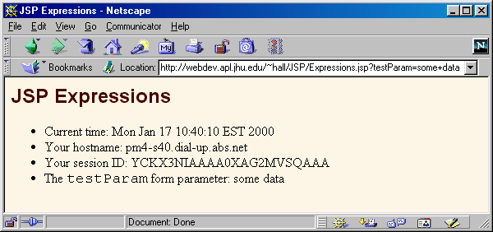
Example Result
If location was
  C:\jakarta-tomcat-4.0\webapps\ROOT\Expressions.jsp or
  C:\Program Files\Allaire\JRun\servers\default\
  default-app\Expressions.jsp
URL would be
  http://localhost/Expressions.jsp
JSP Intro

Slide 12
Most Common Misunderstanding
Forgetting JSP is Server-Side Technology
Very common question
  I can’t do such and such with HTML.
  Will JSP let me do it?
Why doesn’t this question make sense?
  JSP runs entirely on server
  It doesn’t change content the client (browser) can handle
Similar questions
  How do I put a normal applet in a JSP page?
  Answer: send an <APPLET…> tag to the client
  How do I put an image in a JSP page?
  Answer: send an <IMG …> tag to the client
  How do I use JavaScript/Acrobat/Shockwave/Etc?
  Answer: send the appropriate HTML tags
JSP Intro

Slide 13
2nd Most Common Misunderstanding
Translation/Request Time Confusion
What happens at page translation time?
  JSP constructs get translated into servlet code.
What happens at request time?
  Servlet code gets executed. No interpretation of JSP occurs at request time. The original JSP page is totally ignored at request time; only the servlet that resulted from it is used.
When does page translation occur?
  Typically, the first time JSP page is accessed after it is modified. This should never happen to real user (developers should test all JSP pages they install).
  Page translation does not occur for each request.
JSP Intro

Slide 14
The JSP Lifecycle
 | Page first written | Request #1 | Request #2 | Server restarted | Request #3 | Request #4 | Page modified | Request #5 | Request #6
JSP page translated into servlet |  | Yes | No |  | No | No |  | Yes | No
Servlet compiled |  | Yes | No |  | No | No |  | Yes | No
Servlet instantiated and loaded into server's memory |  | Yes | No |  | Yes | No |  | Yes | No
init (or equivalent) called |  | Yes | No |  | Yes | No |  | Yes | No
doGet (or equivalent) called |  | Yes | Yes |  | Yes | Yes |  | Yes | Yes
JSP Intro

Slide 15
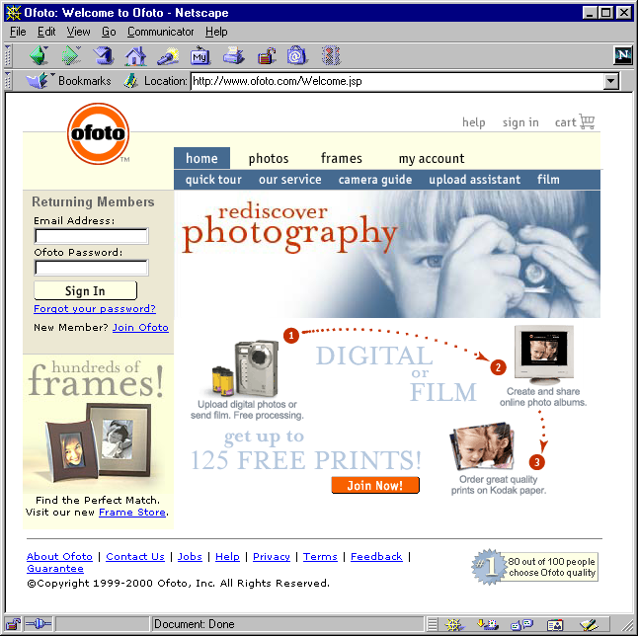
JSP/Servlets in the Real World
ofoto.com:
print and
manage
digital and
conventional
photos.
JSP Intro

Slide 16
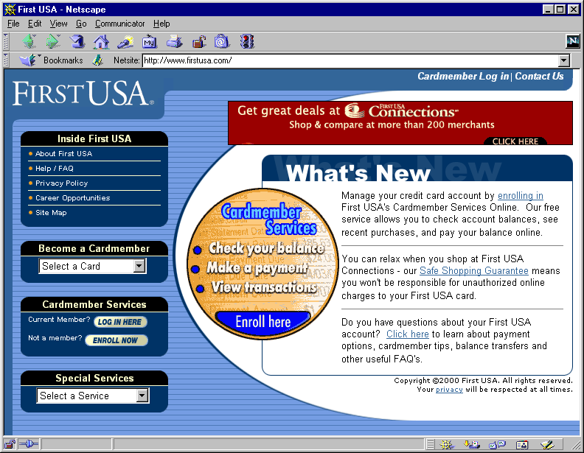
JSP/Servlets in the Real World
First USA Bank: largest credit card issuer in the world; most on-line banking customers
JSP Intro

Slide 17
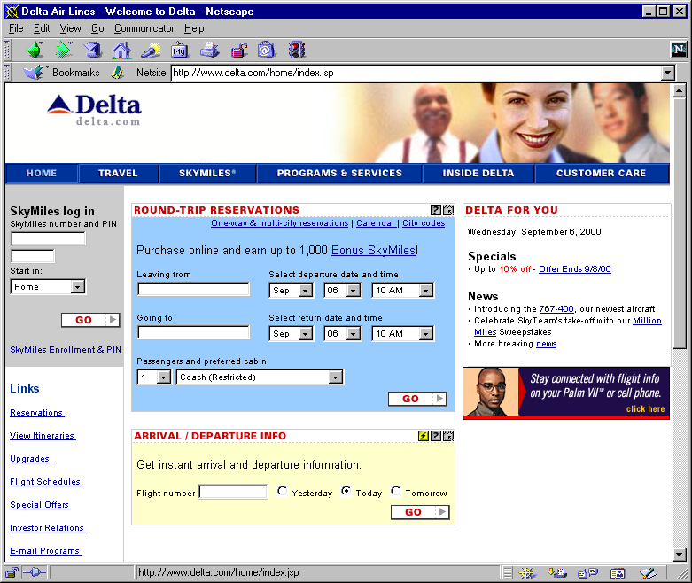
JSP/Servlets in the Real World
Delta Airlines: entire Web site, including real-time schedule info
JSP Intro

Slide 18
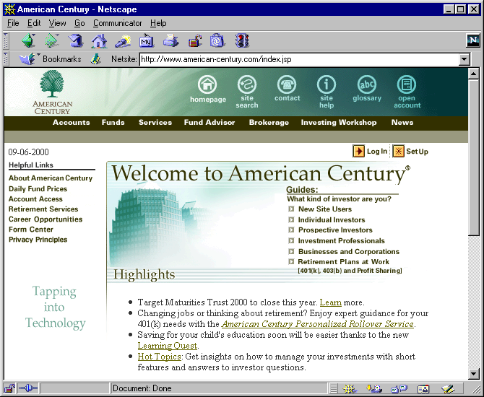
JSP/Servlets in the Real World
American Century Investments: more than 70 mutual funds, $90 billion under management, two million investors
JSP Intro

Slide 19
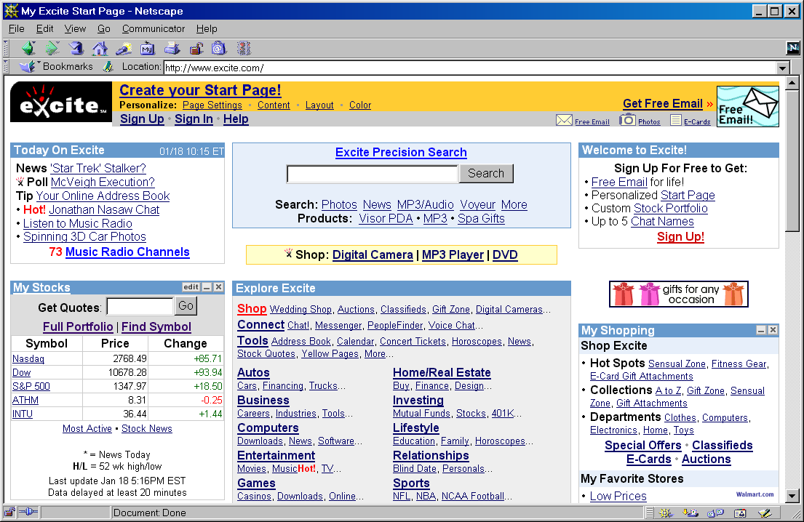
JSP/Servlets in the Real World
Excite: one of the top five Internet portals; one of the ten busiest sites on the Web
JSP Intro

Slide 20
Summary
JSP makes it easier to create and maintain HTML, while still providing full access to servlet code
JSP pages get translated into servlets
  It is the servlets that run at request time
  Client does not see anything JSP-related
You still need to understand servlets
  Understanding how JSP really works
  Servlet code called from JSP
  Knowing when servlets are better than JSP
  Mixing servlets and JSP
Other technologies use similar approach, but aren't as portable and don't let you use Java for the "real code"
JSP Intro

